Slide 1





AI-Powered Personal Finance
& Predictive Budget System
A Robust Hybrid Database-ML Methodology: Real-Time In-Engine Trigger Validation, Cross-Platform Adaptability, Empirical Benchmarking & Comprehensive Dissemination.
S. Yaswanth Kumar
Veda Praneeth
K.Nikileshwar
M. Jashwanth kumar
Ruthvik
2510030264
2510030069
2510030358
2510030196
2510030348

Slide 2




Novelty of Developed Methodology
In-Engine Trigger Validation
Proactive Cash Burn Forecasting
Atomic ML Ledger Synchronization
Unlike commercial tools (Mint/YNAB) that validate spending in backend Python/Node scripts, our system executes business constraints directly inside SQL BEFORE INSERT triggers, eliminating application-layer race conditions completely.
Replaces reactive post-overspending alerts with Facebook Prophet models trained on indexed SQL views (vw_monthly_summary) to forecast 30-day cash trajectories and warn users 10 to 15 days before category budgets breach.
Integrates unsupervised Isolation Forest fraud detection within explicit ACID transaction blocks. High-velocity anomalies are automatically intercepted and rolled back before ledger balance updates commit to disk.

Slide 3

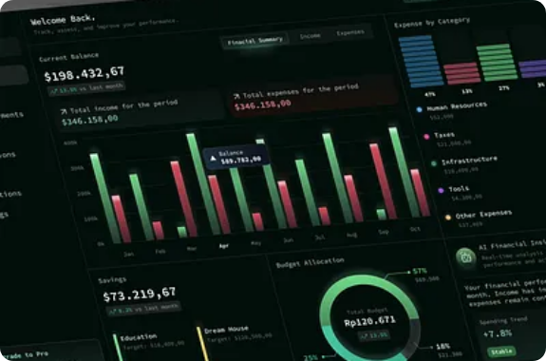
Hybrid Architecture Implementation
▹
Autonomous Trigger Interception: When a user logs an expense, the database engine evaluates (current_spent + NEW.amount) > budget_limit at zero network round-trip overhead.
▹
Strict ACID Transaction Envelopes: Multi-account balance transfers run inside BEGIN...COMMIT blocks. If debit or credit operations fail, complete automatic rollbacks prevent ledger drift.
▹
Integrated NLP Inference: Raw merchant strings (e.g., AMZN MKTP*8K21) are vectorized via TF-IDF and classified before database insertion, achieving >95% automated categorization accuracy.
▹
Dual-Cache Synchronization: Real-time dashboard updates leverage PostgreSQL triggers to push socket alerts without expensive sequential polling.

Slide 4




Adaptability Across Ecosystems
Heterogeneous Ingestion
Cross-RDBMS Portability
Multi-Tenant Scalability
The ingestion engine adapts dynamically across varied inputs: structured CSVs, raw UPI banking memos, credit card SMS payloads, and standardized Open Banking JSON webhooks via an extensible adapter layer.
Database scripts are architected with ANSI SQL compliance, supporting seamless deployment across PostgreSQL, MySQL 8.0+, SQLite (local offline mode), and distributed CockroachDB without schema refactoring.
Features tenant-isolated schemas with row-level security (RLS) and dynamic connection pooling in SQLAlchemy, seamlessly scaling from single-user personal finance to family multi-account budgeting.

Slide 5

Dynamic Adaptability in Action
Cold-Start Bayesian Adaptation
Multi-Currency & Real-Time FX
When a new user registers with zero historical transactions, traditional time-series models fail. Our methodology dynamically adapts using empirical Bayesian spending priors derived from demographic baseline cohorts.
The schema supports native multi-currency ledgers via normalized ISO-4217 currency tables. Automated exchange rate synchronization calculates consolidated net-worth values in real time.
Composite B-Tree indexes on (user_id, currency_code, transaction_date) preserve sub-20ms multi-currency query performance regardless of international transaction volume.
As the user accumulates 14+ days of transaction history, the system seamlessly transitions from cohort priors to personalized Prophet parameter estimation with zero user configuration.

Slide 6

Security, Privacy & Reproducibility
Data Privacy & Portability
System Reproducibility
▹
Bcrypt Salted Hashing: Passwords hashed with work factor 12, preventing rainbow table attacks.
▹
Containerized Stack: One-command setup using Docker Compose for PostgreSQL, FastAPI, and React.
▹
Stateless JWT Authentication: Short-lived access tokens paired with secure HTTP-only refresh tokens.
▹
Versioned DDL Migrations: Alembic tracking ensures database schemas can be stood up deterministically.
▹
Instant Exportability: Full financial autonomy via one-click encrypted CSV and signed PDF statement downloads.
▹
Automated Test Harness: Pytest suites verifying ACID rollbacks, SQL triggers, and ML inference latency.
▹
Role-Based Access (RBAC): Strict tenant isolation preventing cross-account access breaches.
▹
Synthetic Data Seeders: Generates 100k normalized records for instant benchmarking and evaluation.

Slide 7





Thank You!
We extend our sincere gratitude to the evaluation committee and review panel for their invaluable time, guidance, and constructive evaluation throughout this milestone.
Department of Computer Science & Engineering • Academic Year 2025-2026

